Slide 1
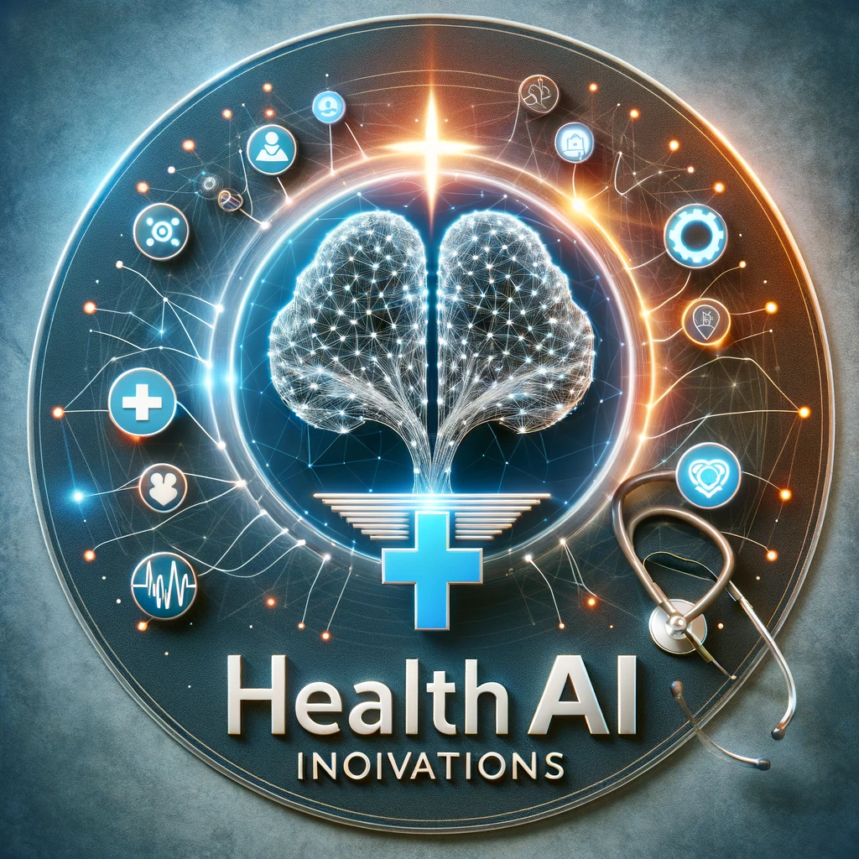
Health AI Innovations
Group Members:
Krishna Kumari Ravuri | M22AI567
Chaitrashree C | M22AI539
J.V.S Kalyan Aashish | M22AI561
Bharathi Sontem | M22AI536
Rakesh Reddy Kadapala | M22AI608
Navyasree | M22AI587
Nagarajan Ranganathan | M22AI666
Innuru Swathi | M22AI668
Ravi Supriya | M22AI611
Bibhukalyan Ojha | M22AI537
Discussion Dates:
March 2nd,3rd, 4th and 5th 2024
Team Leader for Presentation:
Krishna Kumari Ravuri

Slide 2
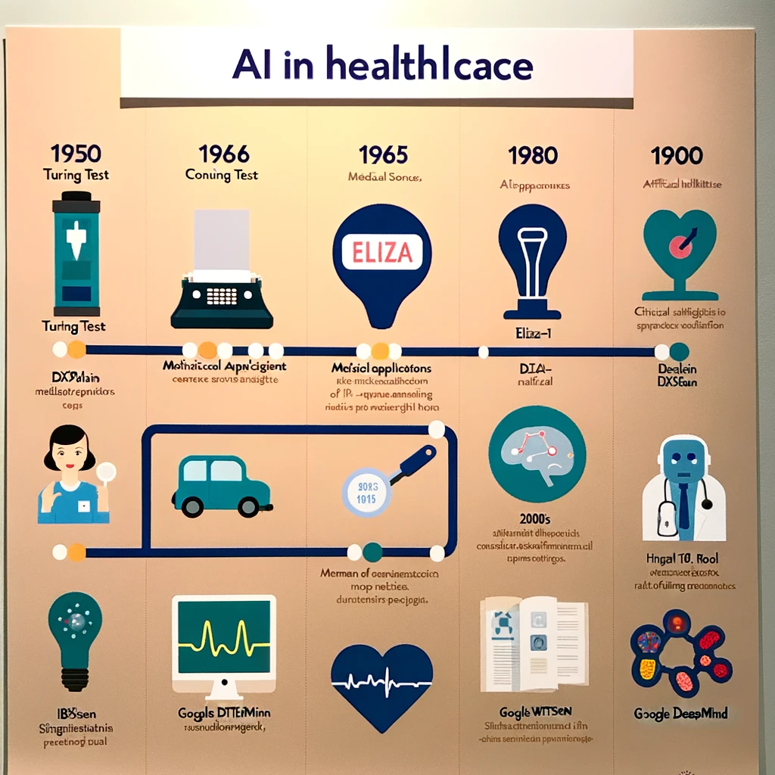
Health AI Innovations Road Map
1964: The first chatbot, Eliza, was created, simulating a conversation between a psychotherapist and a patient.
1970s: AI started being explored for medical applications. For instance
1990s: AI began to assist in more clinical tools and diagnostic processes, such as the CorSage tool developed by Cedars-Sinai cardiologists.
2000s: Significant advancements such as the completion of the Human Genome Project in 2003 provided valuable data for AI applications in genetics and disease.
1964-1970
1990-2000
1950-1956
2010-2024
1971-1980
1950s: The groundwork for AI began, with Alan Turing describing the "Turing test" to assess a machine's capability for human-like intelligence.
1956: The term "artificial intelligence" was coined by John McCarthy.
2010s: IBM's Watson won Jeopardy in 2011 and was later used to identify altered proteins in ALS. By the end of the decade, the FDA had approved AI-powered devices for cancer diagnosis and brain MRI interpretation.
2020s: Google DeepMind made a breakthrough in predicting protein structures, and the FDA authorized numerous AI-powered devices, including tools for heart failure detection from echocardiograms.
1971, INTERNIST-1 was created, an AI system using ranking algorithms for diagnoses.
1980s: University of Massachusetts released DXplain, an AI system that could suggest diagnoses for various diseases.

Slide 3
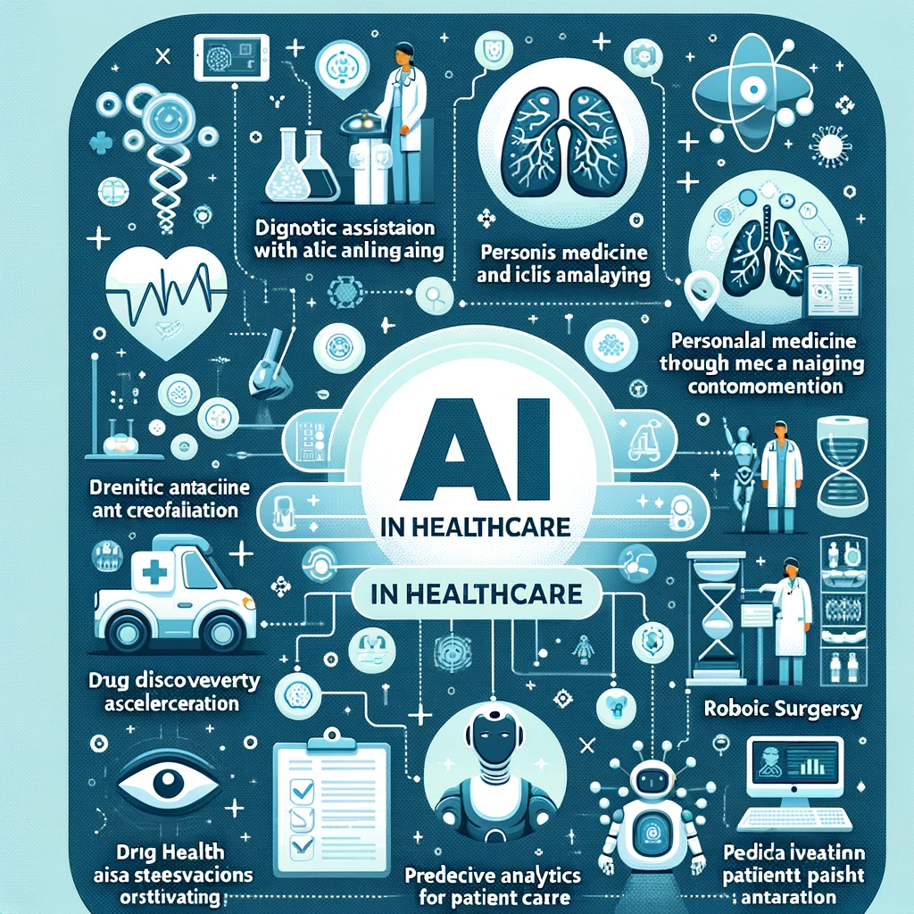
Present Status of the Technology
Diagnostic Tools: AI is enhancing diagnostic accuracy for conditions like cancer and retinal diseases through advanced image analysis.
Personalized Medicine: AI leverages genetic and patient data to tailor treatments, optimizing patient outcomes.
Drug Development: AI accelerates the drug discovery process, identifying potential therapies faster than traditional methods.
Predictive Analytics: AI predicts patient outcomes and hospital readmission rates, improving care planning and resource allocation.
Robotic Surgery: AI-assisted robotic systems are increasing the precision and safety of surgical procedures.
Virtual Assistants: AI-powered chatbots and virtual assistants provide 24/7 support and health monitoring to patients.
Public Health: AI analyzes large datasets to forecast disease outbreaks and inform public health strategies.

Slide 4
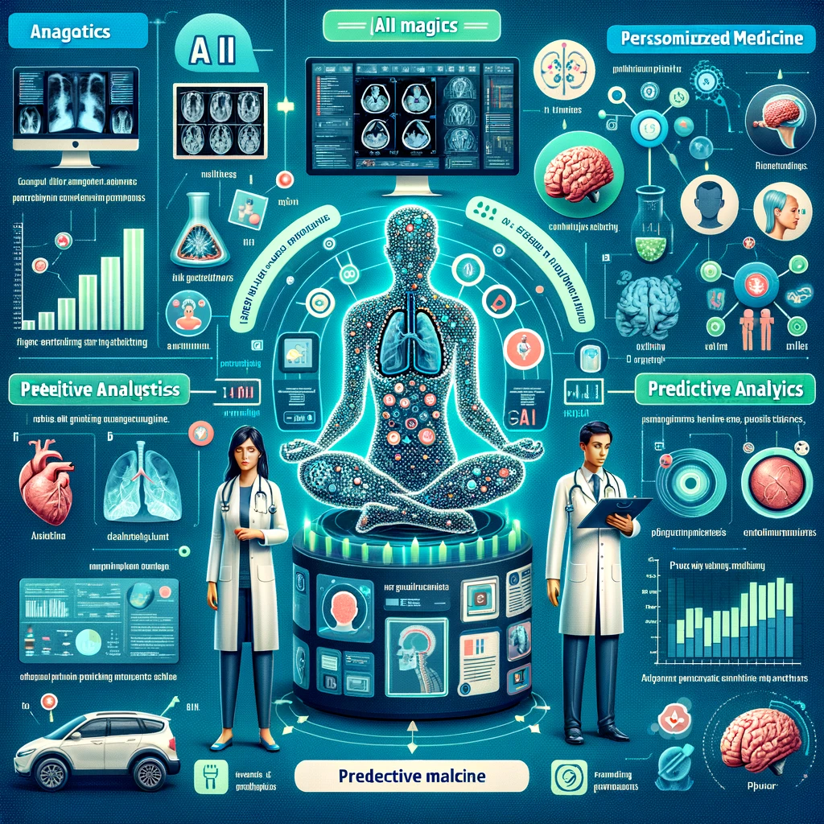
Future Development(2024-2026) Enhanced Diagnostic Tools and Personalized Medicine
Enhanced Diagnostic Accuracy: AI will become increasingly integral to diagnostic processes, especially in the interpretation of medical imaging such as X-rays and CT scans, providing higher precision in identifying conditions.
Efficiency in Diagnostics: The use of AI in interpreting these images is expected to streamline workflows, reducing the time needed for accurate diagnoses.
Surgical Assistance: AI-assisted robotic systems are predicted to assume a more significant role in various surgical procedures.
Real-time Surgical Feedback: These robotic systems will provide surgeons with real-time feedback, enhancing the decision-making process during operations.
Surgical Precision: The precision of surgical procedures is expected to improve due to the advanced capabilities of AI, resulting in minimally invasive interventions and potentially better outcomes for patients.

Slide 5

Future Development (2026-2028) Predictive analytics and Precision medicine
Predictive Analytics: AI will be leveraged to predict health outcomes and disease outbreaks, facilitating preventative healthcare measures.
Precision Medicine: There will be an increased focus on customizing healthcare to individual genetic profiles, with AI analyzing genomic data to personalize treatments.
Data Analysis: AI's ability to process and analyze vast amounts of genomic data will play a critical role in identifying patterns that may indicate disease risks.
Preventative Care: With better predictive analytics, healthcare providers can proactively address potential health issues before they develop into more serious conditions.
Patient Outcomes: The culmination of these AI advancements is expected to markedly improve patient outcomes by enabling early detection and more effective, personalized treatment plans.

Slide 6

Future Development (2028-2030) Telemedicine and Remote Monitoring
Integration with Telehealth: Expect a significant emphasis on incorporating AI technologies into telehealth services, enhancing the quality and accessibility of remote care.
Remote Patient Monitoring: AI will play a pivotal role in advancing remote patient monitoring systems, allowing for more precise and continuous tracking of patient health metrics.
Chronic Disease Management: The use of AI in remote monitoring will be particularly beneficial for patients with chronic diseases, enabling better disease management and potentially reducing hospital visits and admissions.
Use of Wearables and Smart Devices: The integration will extend to wearables and other smart devices, which will collect health data in real-time and use AI to analyze and provide insights for both patients and healthcare providers.
Continuous Health Monitoring: Overall, this integration aims to facilitate continuous health monitoring, offering a proactive approach to healthcare that prioritizes early detection and intervention over reactive treatment.

Slide 7

Future Development (2030-2032) Drug Discovery
Acceleration of Drug Discovery: AI is expected to significantly speed up the drug discovery process, facilitating quicker identification of viable new drug candidates.
Reduction in Time and Cost: By leveraging AI, the pharmaceutical industry could see a reduction in both the time and cost associated with bringing new drugs to the market.
AI-driven Analysis: The use of AI in analyzing biological and chemical data will be crucial for identifying potential drug candidates more efficiently than traditional methods.
Collaborative Efforts: Collaborations between technology companies, healthcare providers, and research institutions are essential to harnessing AI's full potential in drug discovery.
Innovation in Treatment Options: These advancements are expected to lead to the development of new treatment options, potentially transforming patient care and outcomes.

Slide 8

Future Development (2032-2034) Autonomous AI in Surgical Procedures
Development of Autonomous AI Systems: The goal is to create AI systems capable of performing specific surgical procedures autonomously, minimizing the need for human oversight.
Advancement in Robotic Surgery Technology: Focus on enhancing robotic surgery platforms to achieve higher levels of precision and autonomy, incorporating AI to make real-time decisions during surgeries.
AI-driven Decision-making: Integrate sophisticated AI algorithms that can analyze surgical scenarios in real-time, guiding robotic actions to ensure accuracy and the best possible outcomes.
Improved Surgical Success Rates: With the precision and efficiency of AI and robotics, expect to see a notable increase in the success rates of surgeries, ensuring procedures are more effective and reliable.
Enhanced Patient Recovery: The precision and minimal invasiveness facilitated by autonomous AI systems are anticipated to reduce the risk of complications, leading to faster recovery times for patients and improving overall patient care.

Slide 9



